Slide 1


13: Using Window Ranking, Offset, and Aggregate Functions
SQL Server – TSQL Programming Workbook
Module Leader : Mansha Nawaz|
[student#][student=name]| Student Practitioner
TSQL Workbook – Demos, Exercises, Solutions and ICA

Slide 2
Module Overview
Creating Windows with OVER
Exploring Window Functions
This TSQL module will challenge learners who are new to T-SQL.
Plan to stay at a high level in your presentation.
You will have covered regular TSQL - aggregate functions which operate on an entire table and are used with a GROUP BY clause.
But very few people use Window functions in SQL.
These operate on a set of rows and return a single aggregated value for each row.
The main advantage of using Window functions over regular aggregate functions is:
Window functions do not cause rows to become grouped into a single output row,
In Window Functions the rows retain their separate identities and an aggregated value will be added to each row.
Notes:
20761B
8: Using Built-In Functions

Slide 3
SQL Window Functions
Web Resource:
Microsoft Docs|SELECT - OVER Clause (Transact-SQL)
SQL Server Tutorial.net | SQL Server Window Functions
SQLShack | Window functions in SQL Server
JavaTpoint|SQL Server Window Functions

Slide 4


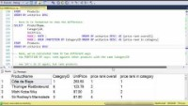
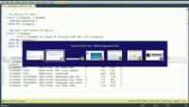
SQL Window Functions
Video links:​
Partition By Row Number function
Rank and Dense Rank in SQL Server
Rank and Over in SQL Server:
sql server Aggregate function Over Clause:

Slide 5
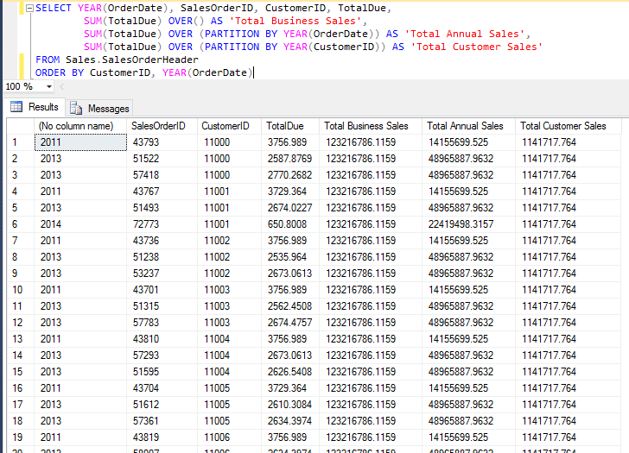
What is Aggregate function with Over in SQL Server
Use the OVER clause to calculate the aggregation on a specific range of value.
The OVER clause can't follow the GROUPING or GROUPING_ID aggregations.
All aggregate functions are deterministic, which means they always return the same value when they run on the same input values.
sql server Aggregate function Over Clause:

Slide 6
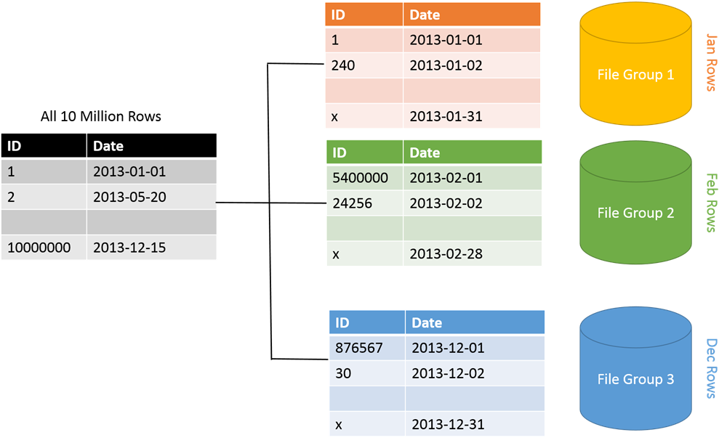
What is partition by in SQL Server?
What is partition by in SQL Server?
SQL PARTITION BY clause overview The PARTITION BY clause is a subclause of the OVER clause. The PARTITION BY clause divides a query’s result set into partitions. The window function is operated on each partition separately and recalculate for each partition.
Partition By Row Number function
Data Science NoSQL platform MongoDB work with ’big data’ Datasets.
We can only work with large Datasets by aggregating, grouping or portioning large collections in order to undertake data analytics.

Slide 7
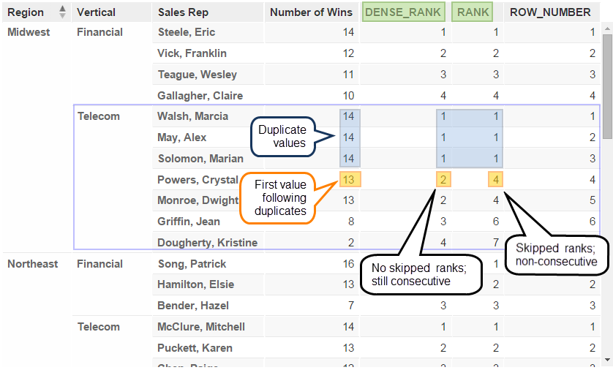
What is Windows Ranking in Sql Server
Ranking functions are a subset of the built in functions in SQL Server.
They are used to provide a rank of one kind or another to a set of rows in a partition.
The partition can be the full result set, if there is no partition.
Rank and Dense Rank in SQL Server

Slide 8
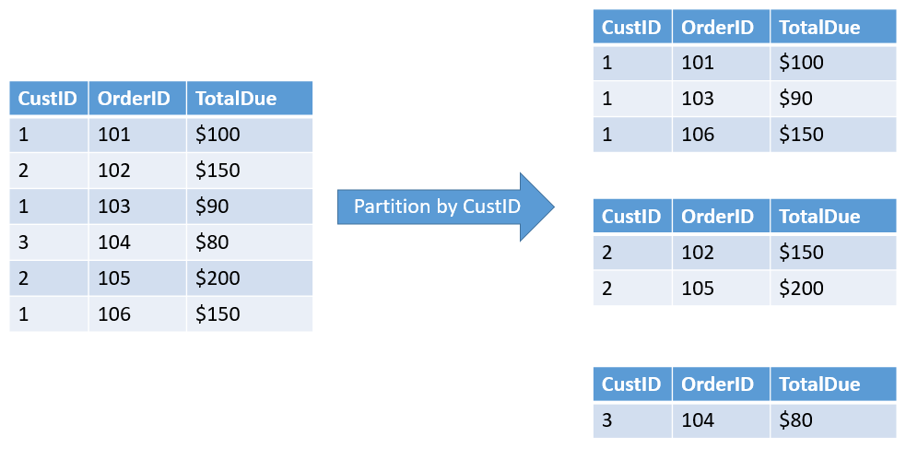
What is OVER Clause in SQL Server?
What is OVER Clause in SQL Server?
The OVER clause in SQL Server is used with PARTITION BY to break up the data into partitions. Following is the syntax of the OVER clause. The specified function is going to operate for each partition. See the following example. Let say we have three departments (HR, IT, Payroll). COUNT (Department) OVER (PARTITION BY Department)
Rank and Over:

Slide 9
Module Overview
Views
Temporary Tables
Table Variables
Table-Valued Functions
Derived Tables
Common Table Expressions

Slide 10
Querying Views
Views are named queries with definitions stored in a database
Views can provide abstraction, encapsulation and simplification
From an administrative perspective, views can provide a security layer to a database
Views may be referenced in a SELECT statement just like a table
Use AdventureWorks2019;
GO
CREATE VIEW Sales.vSalesOrders
AS
SELECT oh.SalesOrderID, oh.Orderdate, oh.CustomerID,
od.ProductID, od.OrderQty, od.LineTotal
FROM Sales.SalesOrderHeader AS oh
JOIN Sales.SalesOrderDetail AS od
ON od.SalesOrderID = oh.SalesOrderID;
SELECT OrderID, CustomerID, ProductID
FROM Sales.vSalesOrder
ORDER BY OrderID;

Slide 11
Querying Views

Slide 12
Temporary Tables
CREATE TABLE #tmpProducts
(ProductID INTEGER,
ProductName varchar(50));
GO
…
SELECT * FROM #tmpProducts;
Temporary tables are used to hold temporary result sets within a user’s session
Created in tempdb and deleted automatically
Created with a # prefix
Global temporary tables are created with ## prefix

Slide 13
Table Variables
DECLARE @varProducts table
(ProductID INTEGER,
ProductName varchar(50));
…
SELECT * FROM @varProducts
Introduced because temporary tables can cause recompilations
Used similarly to temporary tables but scoped to the batch
Use only on very small datasets

Slide 14
Temporary Tables and Table Variables

Slide 15
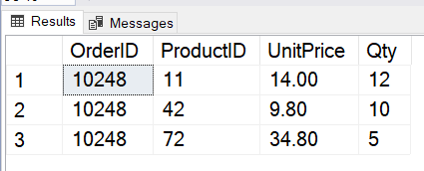
Table-Valued Functions
Use TSQL
Go
SELECT OrderID, ProductID, UnitPrice, Qty
FROM Sales.OrderDetails
-- creating a function to return – GetOrderItem for specific order
CREATE FUNCTION Sales.fn_GetOrderItems (@OrderID AS Integer)
RETURNS TABLE
AS
RETURN
(SELECT OrderID, ProductID, UnitPrice, Qty
FROM Sales.OrderDetails
WHERE OrderID = @OrderID);
-- executing the new function
SELECT * FROM Sales.fn_GetOrderItems (10248) AS LineItems;
TVFs are named objects with definitions stored in a database
TVFs return a virtual table to the calling query
Unlike views, TVFs support input parameters
TVFs may be thought of as parameterized views

Slide 16
Using Table-Valued Functions

Slide 17
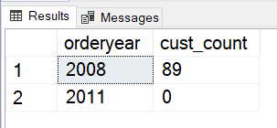
Derived Tables
SELECT orderyear, COUNT(DISTINCT custid) AS cust_count
FROM
(SELECT YEAR(orderdate) AS orderyear, custid
FROM Sales.Orders) AS derived_year
GROUP BY orderyear;
Derived tables are named query expressions created within an outer SELECT statement
Not stored in database – represents a virtual relational table
Scope of a derived table is the query in which it is defined

Slide 18
Derived Tables
Derived tables must:
Have an alias
Have unique names for all columns
Not use an ORDER BY clause (without TOP or OFFSET/FETCH)
Not be referred to multiple times in the same query
Derived tables may:
Use internal or external aliases for columns
Refer to parameters and/or variables
Be nested within other derived tables

Slide 19
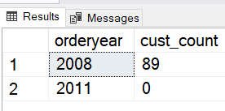
Derived Tables
Column aliases may be defined inline:
Or externally:
SELECT orderyear, COUNT(DISTINCT custid) AS cust_count
FROM (SELECT YEAR(orderdate) AS orderyear, custid
FROM Sales.Orders) AS derived_year
GROUP BY orderyear;
SELECT orderyear, COUNT(DISTINCT custid) AS cust_count
FROM (SELECT YEAR(orderdate), custid
FROM Sales.Orders) AS
derived_year(orderyear, custid)
GROUP BY orderyear;

Slide 20
Using Derived Tables

Slide 21
Common Table Expressions (CTEs)
WITH CTE_year (OrderYear, CustID)
AS
(
SELECT YEAR(orderdate), custid
FROM Sales.Orders
)
SELECT OrderYear, COUNT(DISTINCT CustID) AS Cust_Count
FROM CTE_year
GROUP BY orderyear;
CTEs are named table expressions defined in a query
CTEs are similar to derived tables in scope and naming requirements
Unlike derived tables, CTEs support multiple references and recursion

Slide 22
Common Table Expressions
WITH OrgReport (ManagerID, EmployeeID, lastname, firstname, Level)
AS
(
SELECT e.mgrid, e.empID, lastname, firstname, 0
FROM HR.Employees AS e
WHERE mgrID IS NULL
UNION ALL
SELECT e.mgrID, e.empID, e.lastname, e.firstname, Level + 1
FROM HR.Employees AS e
INNER JOIN OrgReport AS o ON e.mgrID = o.EmployeeID
)
SELECT * FROM OrgReport
OPTION (MAXRECURSION 3);
Specify a query for the anchor (root) level
Use UNION ALL to add a recursive query for other levels
Query the CTE, with optional MAXRECURSION option

Slide 23
Using Common Table Expressions

Slide 24
Using Table Expressions
Views
Temporary Tables
Table Variables
Table-Valued Functions
Derived Tables
Common Table Expressions
Lab: Using Table Expressions

Slide 25
Lesson 1: Creating Windows with OVER
SQL Windowing
Windowing Components
Using OVER
Partitioning Windows
Ordering and Framing
Demonstration: Using OVER and Partitioning
SQL PARTITION BY
We can use the SQL PARTITION BY clause with the OVER clause to specify the column on which we need to perform aggregation.
In the previous example, we used Group By with CustomerCity column and calculated average, minimum and maximum values.
Notes:
20761B
8: Using Built-In Functions

Slide 26
SQL Windowing
Windows extend T-SQL's set-based approach
Windows allow you to specify an order as part of a calculation, without regard to order of input or final output order
Windows allow partitioning and framing of rows to support functions
Window functions can simplify queries that need to find running totals, moving averages, or gaps in data
Note: The example is provided as an all-at-once view of windowing functions in use. Don't get bogged down in its details yet. The source, as well as the view definition, is provided in the demonstration script for this lesson.
Query description: This query returns a running total of quantity per product category. The running total will reset to zero at each change in category (partition) and is the sum of all previous rows in the current category (unbounded preceding) up to the current row.
SELECT Category, Qty, Orderyear,
SUM(Qty) OVER (
PARTITION BY category
ORDER BY orderyear
ROWS BETWEEN UNBOUNDED PRECEDING
AND CURRENT ROW) AS RunningQty
FROM Sales.CategoryQtyYear;
You will need to create a View – Sales.CategoryQtyYear for this TSQL code to work – provided in the Demo Script File
Notes:
20761B
8: Using Built-In Functions

Slide 27
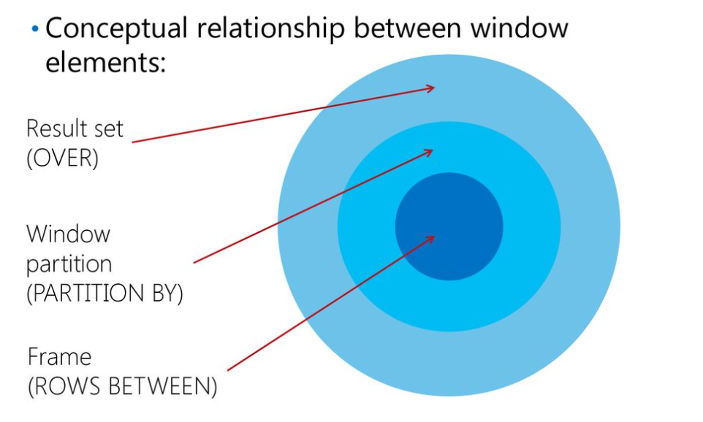
Using the UNION Operator
Conceptual relationship between window elements:
The result set is the window of rows defined by the OVER clause.
If there is no partition, then the window includes all rows.
If a partition element is defined in the OVER clause, the conceptual subset of rows is called the window partition.
If a frame is defined, the window is further restricted to the starting and ending boundaries defined by the frame.
Result set
(OVER)
Window partition
(PARTITION BY)
Frame (ROWS BETWEEN)
Do not be concerned with the terminology since the main focus is on generating virtual column data such as running totals or averages
Notes:
If you are comfortable with execution plans and feel that the class won’t be too confused, consider displaying and comparing the execution plans from the UNION example in this topic and the UNION ALL example in the next one.
20761B
8: Using Built-In Functions

Slide 28
Using OVER
OVER defines a window, or set, of rows to be used by a window function, including any ordering
With a specified window partition clause, the OVER clause restricts the set of rows to those with the same values in the partitioning elements
By itself, OVER() is unrestricted and includes all rows
Multiple OVER clauses can be used in a single query, each with its own partitioning and ordering, if needed
For example:
OVER ( [ <PARTITION BY clause> ]
[ <ORDER BY clause> ]
[ <ROWS or RANGE clause> ]
SUM(<col>) OVER () means to calculate the aggregate (SUM) using the underlying query's result set (all rows).
SUM(<col>) OVER (PARTITION BY <col>) means to calculate the aggregate once for each window of rows restricted to only those rows with the same value in <col> as in the current row.
Notes:
If you are comfortable with execution plans and feel that the class won’t be too confused, consider displaying and comparing the execution plans from the UNION example in this topic and the UNION ALL example in the next one.
20761B
8: Using Built-In Functions

Slide 29
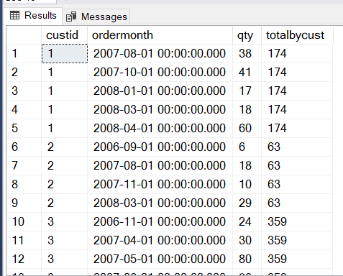
Partitioning Windows
Partitioning limits a set to rows with the same value in the partitioning column
Use PARTITION BY in the OVER() clause
Without a PARTITION BY clause defined, OVER() creates a single partition of all rows
Don't take the comparison too far, but PARTITION is conceptually similar to a GROUP BY, even if the mechanisms are very different.
SELECT custid, ordermonth, qty,
SUM(qty) OVER(PARTITION BY custid)
AS totalbycust
FROM Sales.CustOrders;
Over PARTITION generating virtual column data such as running totals or averages to appear with each row of data
Notes:
20761B
8: Using Built-In Functions

Slide 30
Ordering and Framing
Window framing allows you to set start and end boundaries within a window partition
UNBOUNDED means go all the way to boundary in direction specified by PRECEDING or FOLLOWING (start or end)
CURRENT ROW indicates start or end at current row in partition
ROWS BETWEEN allows you to define a range of rows between two points
Window ordering provides a context to the frame
Sorting by an attribute enables meaningful position of a boundary
Without ordering, "start at first row" is not useful because a set has no order
Notes:
If you are comfortable with execution plans and feel that the class won’t be too confused, consider displaying and comparing the execution plans from the UNION example in this topic and the UNION ALL example in the next one.
20761B
8: Using Built-In Functions

Slide 31
Lesson 2: Exploring Window Functions
Define Windows Function
Windows Aggregate Function
Windows Ranking Function
Windows Distribution Function
Windows Offset Function
Demonstration: Exploring Windows Functions
Notes:
If you are comfortable with execution plans and feel that the class won’t be too confused, consider displaying and comparing the execution plans from the UNION example in this topic and the UNION ALL example in the next one.
20761B
8: Using Built-In Functions

Slide 32
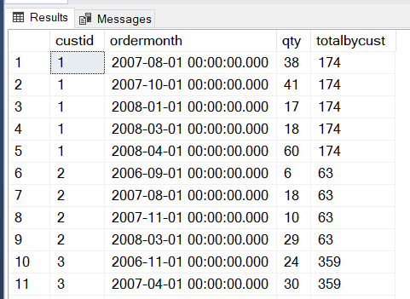
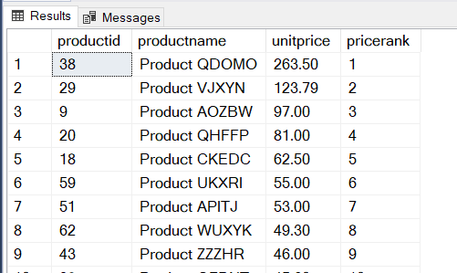
Defining Window Functions
A window function is a function applied to a window, or set, of rows
Window functions include aggregate, ranking, distribution, and offset functions
Window functions depend on set created by OVER()
SELECT productid, productname, unitprice,
RANK() OVER(ORDER BY unitprice DESC) AS pricerank
FROM Production.Products
ORDER BY pricerank;
SELECT custid, ordermonth, qty,
SUM(qty) OVER(PARTITION BY custid)
AS totalbycust
FROM Sales.CustOrders;
Notes:
DESC is for descending order
ASC is for ascending order
Demo the ASC version as well
20761B
8: Using Built-In Functions

Slide 33
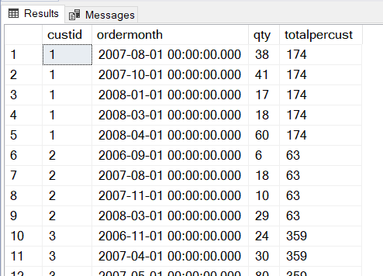
Window Aggregate Functions
Similar to grouped aggregate functions
SUM, MIN, MAX, and so on
Applied to windows defined by OVER clause
Window aggregate functions support partitioning, ordering, and framing
SELECT custid, ordermonth, qty,
SUM(qty) OVER(PARTITION BY custid)
AS totalpercust
FROM Sales.CustOrders;
Notes:
20761B
8: Using Built-In Functions

Slide 34
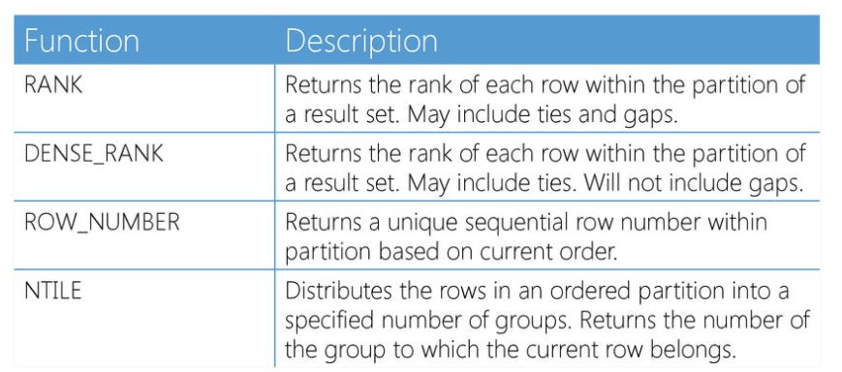
Window Ranking Functions
Ranking functions require a window order clause
Partitioning is optional
To display results in sorted order still requires ORDER BY!
Remember that any ORDER BY within an OVER clause does not determine the order of the final result set.
Using an additional ORDER BY clause to set output order.
Notes:
If you are comfortable with execution plans and feel that the class won’t be too confused, consider displaying and comparing the execution plans from the UNION example in this topic and the UNION ALL example in the next one.
20761B
8: Using Built-In Functions

Slide 35
Window Ranking Functions
Ranking functions require a window order clause
Partitioning is optional
To display results in sorted order still requires ORDER BY!
Remember that any ORDER BY within an OVER clause does not determine the order of the final result set.
Using an additional ORDER BY clause to set output order.
Notes:
If you are comfortable with execution plans and feel that the class won’t be too confused, consider displaying and comparing the execution plans from the UNION example in this topic and the UNION ALL example in the next one.
20761B
8: Using Built-In Functions

Slide 36
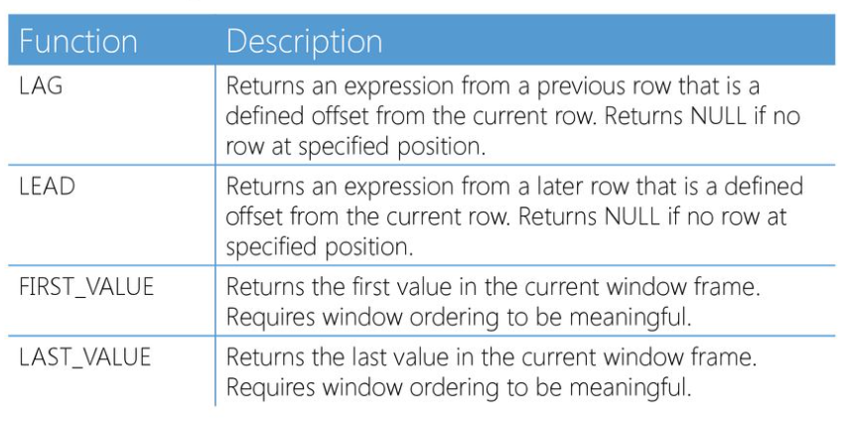
Window Offset Functions
Window offset functions allow comparisons between rows in a set without the need for a self-join
Offset functions operate on a position relative to the current row, or to the start or end of the window frame
The default window framing is RANGE BETWEEN UNBOUNDED PRECEDING AND CURRENT ROW.
Therefore, for LAST_VALUE to return something other than the current row, the framing needs to be set, such as to UNBOUND FOLLOWING, which will then include all subsequent rows in the window frame.
Notes:
20761B
8: Using Built-In Functions

Slide 37
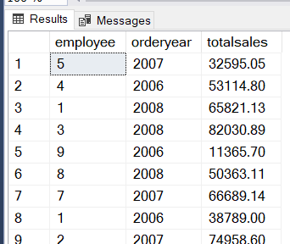
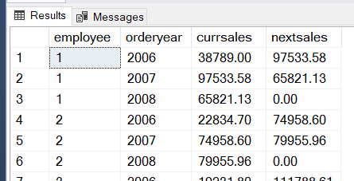
One of the Demo Examples: LEAD Offset Window Function
CREATE VIEW Sales.OrdersByEmployeeYear
AS
SELECT emp.empid AS employee, YEAR(ord.orderdate) AS orderyear, SUM(od.qty * od.unitprice) AS totalsales
FROM HR.Employees AS emp
JOIN Sales.Orders AS ord ON emp.empid = ord.empid
JOIN Sales.OrderDetails AS od ON ord.orderid = od.orderid
GROUP BY emp.empid, YEAR(ord.orderdate)
GO
SELECT employee, orderyear ,totalsales AS currsales,
LEAD (totalsales, 1,0) OVER (PARTITION BY employee
ORDER BY orderyear) AS nextsales
FROM Sales.OrdersByEmployeeYear
ORDER BY employee, orderyear;
Notes:
20761B
8: Using Built-In Functions

